Slide 1
Marketing Campaign Performance & Analysis
Presented By: Araoye A. A.
Date: 2/13/2025

Slide 2
INTRODUCTION
Perform exploratory data analysis (EDA) on a marketing dataset to uncover key insights that can guide strategic decision-making.
Objective: To analyze the performance of marketing strategies based on key metrics.
Scope:
Evaluating campaign effectiveness by Campaign Type, Channel Used, Location, and Target Audience.
Identifying patterns in key performance indicators (KPIs) such as ROI, CTR, CPC and Conversion Rate.
Providing actionable recommendations to optimize marketing stratehies.
Dataset Name: Marketing Campaign Dataset
Key Columns:
Company, Campaign_Type, Target_Audience, Duration, Channels_Used, Conversion_Rate, Acquisition_Cost, ROI, Location, Date, Clicks, Impressions, Engagement_Score, Customer_Segment,
Size: 200,005 rows (24.5MB)

Slide 3
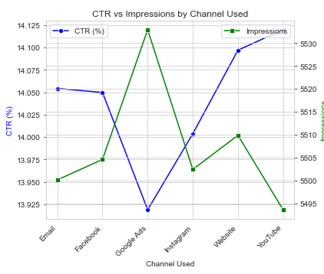
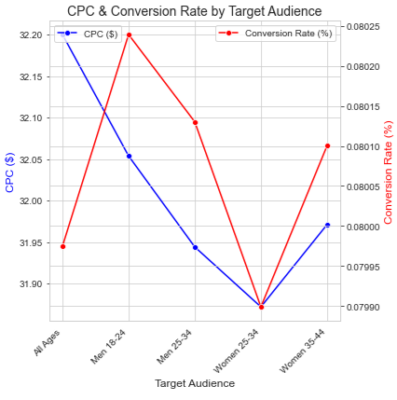
Findings & Insights CTR vs Impressions
Higher impressions do not always guarantee a higher CTR.
Google Ads & Website Channels have high impressions but varied CTR results
Men aged 18-24 had the highest conversion rate.
Women 25-34 had a balanced Conversion Date against CPC.

Slide 4
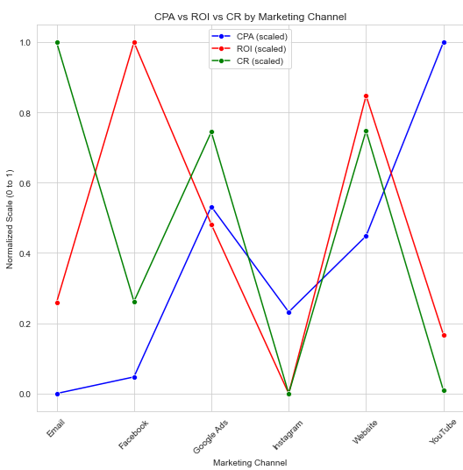
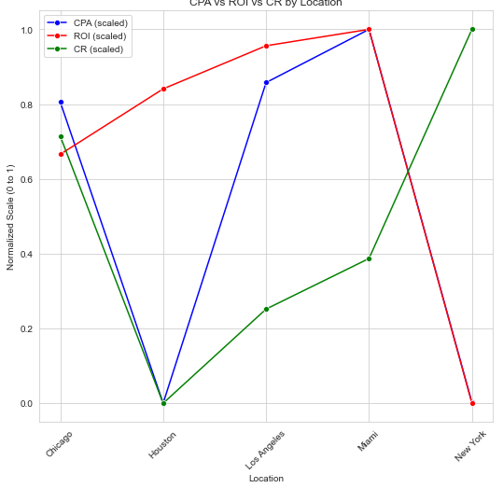
By Marketing Channel
Facebook Ads and Websites offer strong ROI with relatively low CPA.
Facebook Ads had lower CPA and better conversion efficiency.
By Location
Los Angeles & Miami generated the highest ROI.
Houston had lower CPA making it a cost-effective region.

Slide 5
Actionable Recommendations/ Conclusions & Next Steps
Optimize Ads Spend:
Shift budget towards high ROI channels like Facebook and Website and also enhance Ad creatives for other channels like Google Ads and Instagram.
Refine Targeting Strategy:
Prioritize audience segments with high CTR and Conversions like Men 18-24, Men 25-24 and Women 34-44 as they generate high ROI and high conversion rate at low CPC.
Adjust strategy for underperforming segments
Leverage Regional Performance Insights:
Increase efforts in Los Angeles and Miami for better Conversions.
Expand Houston campaigns due to its lower CPC.
Conclusion
Focus on high performing strategies, reallocate budget wisely, and enhance engagement,
Next Steps
Implement A/B testing, refine targeting, and optimize high-ROI campaigns.
Final Thought
Aligning data-driven insights with marketing execution will maximize efficiency and results.

Slide 6
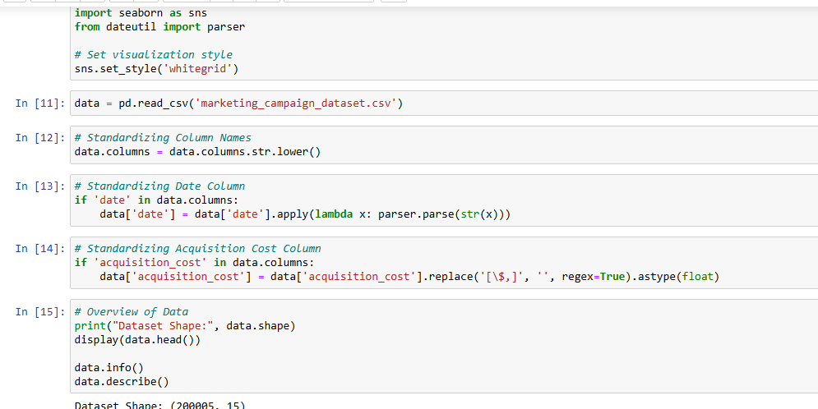
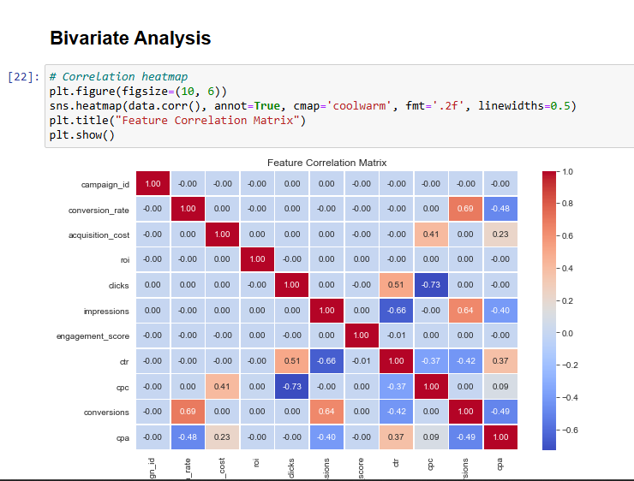
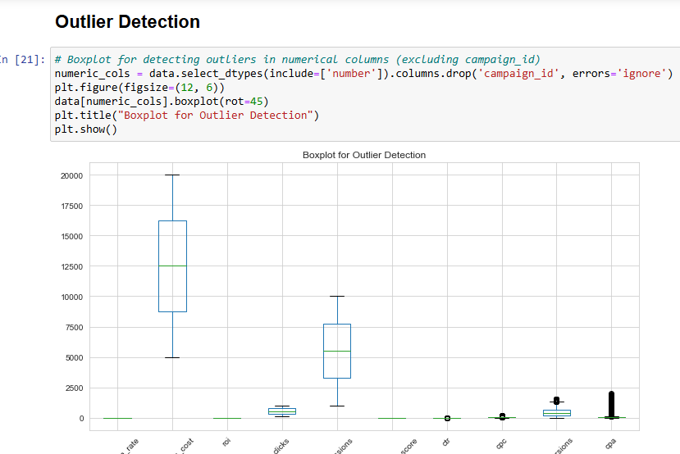
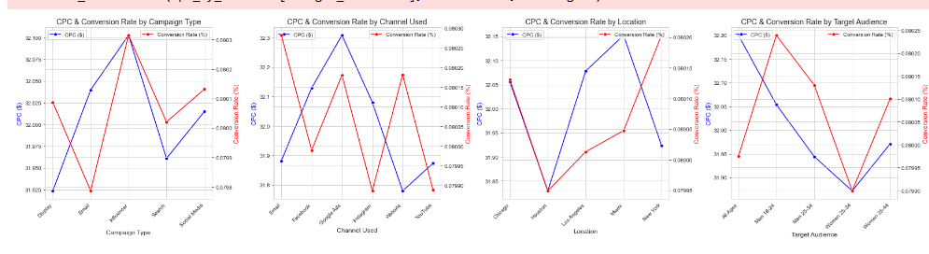
Code & Methodology
Programming Language: Python
Libraries Used: Pandas, Matplotlib, Seaborn, NumPy, Parser from DateUtil
Key Analysis Steps:
Data Cleaning & Preprocessing
Exploratory Data Analysis
Statistical Analysis
Visualization & Interpretation

Slide 7
Thank you!!
max growth
Marketing Campaign Performance and Analysis.

